Slide 1

COMM223 Marketing Management
Lecture 5 - Segmentation, targeting, and positioning

Slide 2
Agenda
Segmentation
Targeting
Differentiation and positioning

Slide 3
Where are we now …
Company
Company Analysis
Competitor Analysis
Consumer Analysis
Marketing Management
Competitor
Consumer
Product
Promotion
Price
Distribution
Product - Market

Slide 4
Why Market Segmentation?
Who are the customers?
Do they all want the same thing?
Do they all buy it in the same place?
Do they all use it in the same way?
Do they get all their information from the same source?
Do they all use the same substitutes?
Do they…..Do they……Do they???
No, they do not!

Slide 5
A Simple Stylized Example
Two groups of people:
Group 1: 5000 members
Willing to pay up to $15 for a good
Group 2: 1000 members
Willing to pay up to $25 for a good
Cost of manufacturing the good: $5
How should you price this good?

Slide 6
A Simple Stylized Example (contd..)
Price at $15:
Profits: 5000*(15-5)+1000*(15-5)=$60,000
Price at $25
Profits: 5000*0+1000*(25-5)=$20,000
So should we price at $15 to attract maximum number of consumers?

Slide 7
A Simple Stylized Example (contd..)
There is possibility of improving the product a bit by adding $1 to the cost
Make two products:
Product1, the same as before , costing $5
Product2, improved version, costing $6
Sell product 1 at $15
Sell product 2 at $25

Slide 8
A Simple Stylized Example (contd..)
The consumers with higher willingness to pay will buy improved version
Profits in two product situation:
5000*(15-5)+1000*(25-6)= $69,000
Much higher than all the other cases!
This is differentiation!!
Achieved by segmentation!
This is common in many categories such as software, book, etc…

Slide 9
Why Segment the Market?
Efficiency – target those consumers with the greatest likelihood of buying the product, making marketing efforts more efficient.效率——瞄准那些最有可能购买产品的消费者，使营销工作更有效率。
Divide and conquer – tailor the marketing mix program within each targeted segment to best match customer needs and provide superior value compared to the competitors. 分而治之——在每个目标细分市场中定制营销组合计划，以最好地满足客户需求并提供比竞争对手更高的价值。
Opportunity -- identify new opportunities not discovered by competitors.机会——发现竞争对手没有发现的新机会。

Slide 10
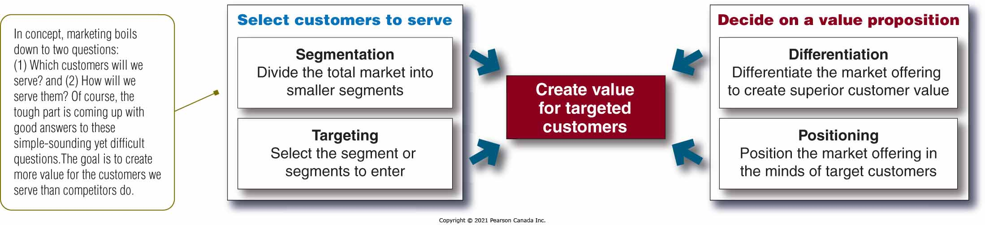
Customer-Driven Marketing Strategy

Slide 11
Market Segmentation
Market segmentation: dividing market into distinct groups with distinct needs, characteristics, or behaviours, who might require separate products or marketing mixes市场细分：将市场划分为具有不同需求、特征或行为的不同群体，这些群体可能需要单独的产品或营销组合
No single way to segment a market
Any variables can be used as the basis for segmentation任何变量都可以作为分割的依据
One variable
Combination of several variables
一个变量
几个变量的组合

Slide 12
Major Segmentation Variables for Consumer Markets
Segmentation Variable | Examples
Geographic | Nations, regions, provinces, cities, neighbourhoods, population density (urban, suburban, rural), climate
Demographic | Age, life-cycle stage, gender, income, occupation, education, religion, ethnicity, generation
Psychographic | Social class, lifestyle, personality
Behavioural | Occasions, benefits, user status, usage rate, loyalty status

Slide 13
Base for Segmentation Variables in Geographic Base
By Region
City vs. Rural
By Climate
By Density

Slide 14
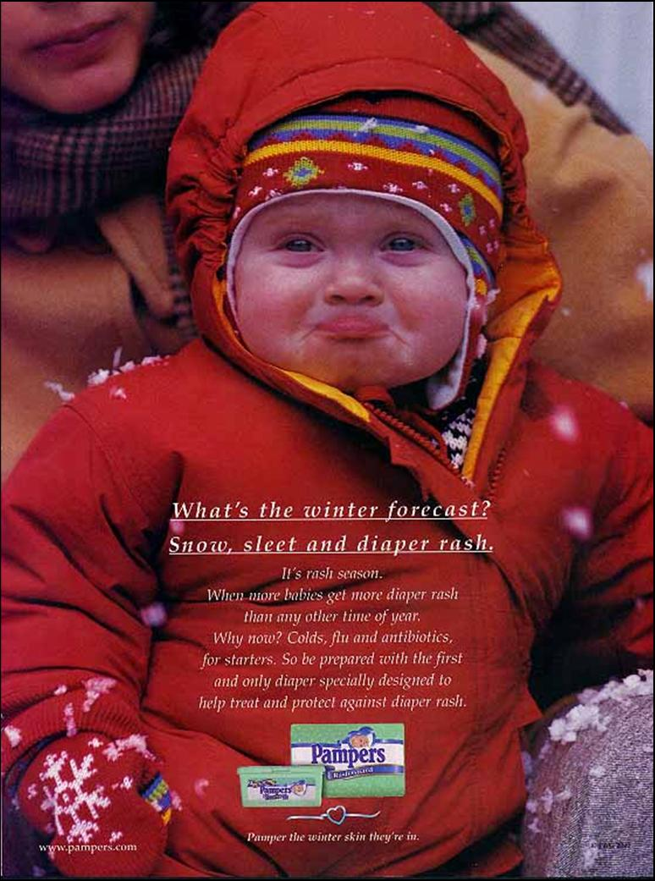
Base for Segmentation Variables in Demographic Base
Age, gender, Family size
Family life cycle
Income
Occupation, education
Race, nationality

Slide 15

Base for Segmentation Variables in Psychographic Base
Social Class
Lifestyle
Personality

Slide 16
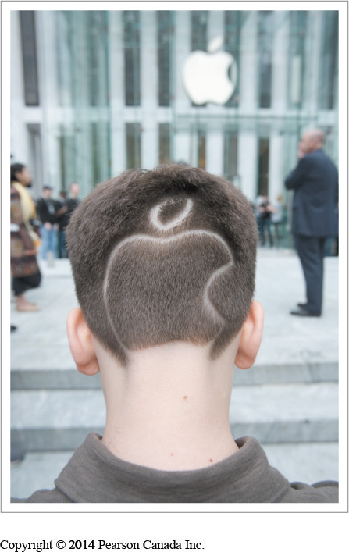
Base for Segmentation Variables in Behavioral Base
Occasions
Benefits
User Status
Usage Rate
Loyalty Status

Slide 17
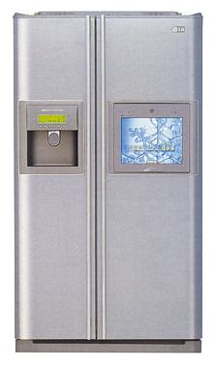
Behavioral Segmentation Variables
This fridge with a built in TV is targeted to the owner who watches television in the kitchen and has a design that faces the fridge

Slide 18


Typical Harley Davidson Rider?

Slide 19

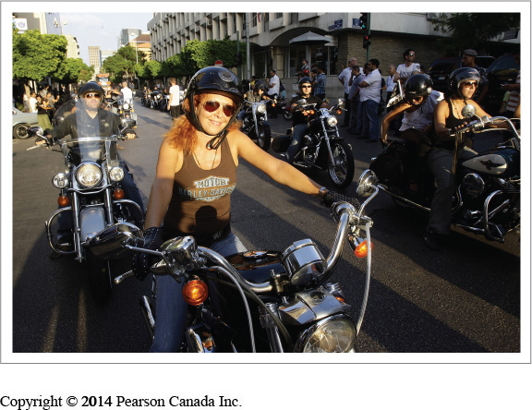
Harley’s other Customers ---“Rubbies”

Slide 20
Multiple Segmentation Bases
Multiple bases used to better identify segments
Smaller, better defined segments
Geodemographic segmentation
Combining demographic with geographic 人口与地理相结合
For example, income with information on regional differences例如，带有地区差异信息的收入
Affluent consumers living in QC, versus affluent consumers living in Rest of Canada居住在 QC 的富裕消费者与居住在加拿大其他地区的富裕消费者

Slide 21
Segments should be characterized by..
Homogeneous consumers within segments细分市场内的同质消费者
Heterogeneous consumers across segments跨细分市场的异质消费者

Slide 22
Segmenting Business Markets
Consumer and business markets use many of the same variables for segmentation.消费者和商业市场使用许多相同的变量进行细分。
Variables used by business marketers for segmentation include商业营销人员用于细分的变量包括
Operating characteristics操作特性
Purchasing approaches采购方式
Situational factors情境因素
Personal characteristics人物的特征

Slide 23
Segmenting International Markets
Variables include
Geographic location
Economic factors
Political and legal factors
Cultural factors
Intermarket (cross-market) segmentation: Grouping consumers with similar needs and buying behaviours irrespective of their location.跨市场（跨市场）细分：将具有相似需求和购买行为的消费者分组，无论其位于何处。

Slide 24
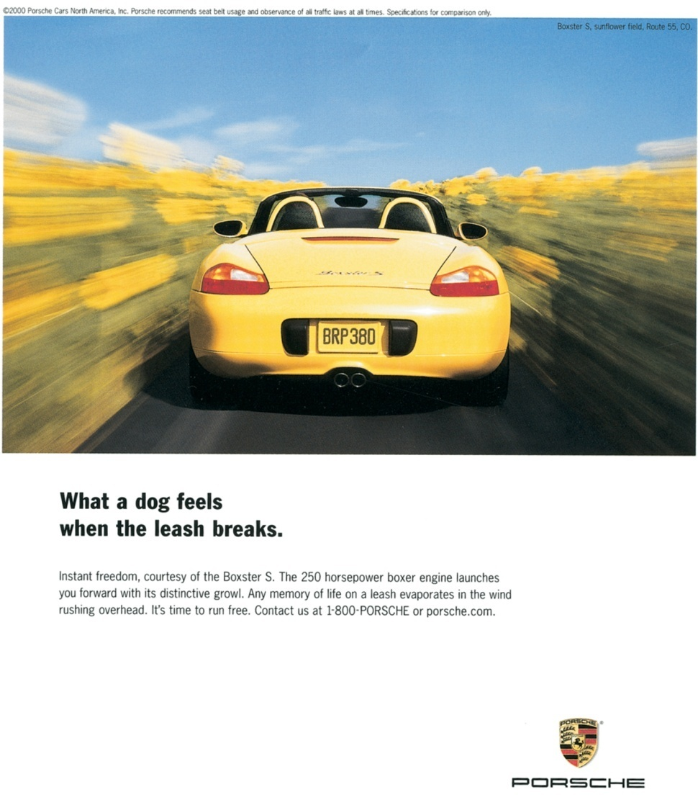
Segmenting Markets Effectively
Measurable
Size, purchasing power, and profile of segment
Accessible
Can be reached and served
Substantial
Large and profitable enough to serve
Differentiable
Respond differently
Actionable
Effective programs can be developed

Slide 25











Segment the market
Divide the market into distinct and homogeneous groups
Call for distinct products/marketing mixes

Slide 26
Target Marketing
Target Market
Consists of a set of buyers who share common needs or characteristics that the company decides to serve

Slide 27
Target Marketing
Evaluating Market Segments
Segment size and growth
Segment structural attractiveness
Level of competition
Substitute products
Power of buyers
Powerful suppliers
Company objectives and resources

Slide 28
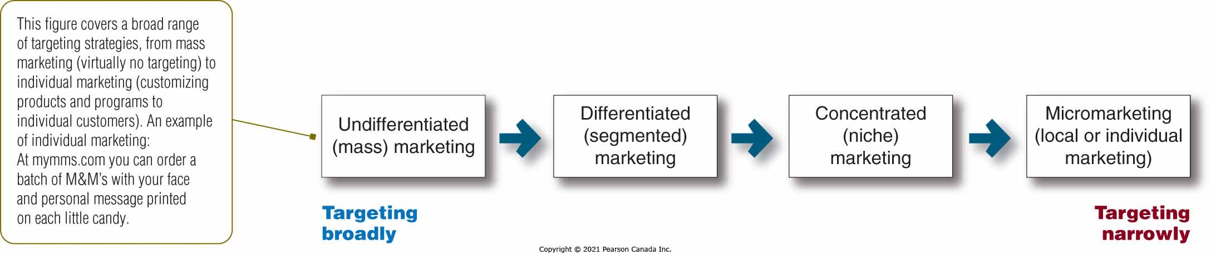
Target Marketing Strategies

Slide 29
Target Marketing Undifferentiated (mass) Marketing
Ignoring market segment differences and targeting the whole market with one offer
Advantages:
Potential savings on production and marketing costs
Disadvantages:
Hard to satisfy all consumers
Company more susceptible to competition

Slide 30
Target Marketing Differentiated (segmented) Marketing
Targeting several market segments and designing separate offers for each
Advantages:
Stronger position within several segments
More total sales
Disadvantages:
High costs
cannibalization

Slide 31
Target Marketing Concentrated (niche) Marketing
Pursuing a large share of one or a few submarkets
Advantages:
More effectively and efficiently
An opportunity for small company to compete
Can be highly profitable
Disadvantages:
Higher than normal risks
Threat from large competitors

Slide 32
Target Marketing Micromarketing
Tailoring products and marketing programs to the needs/wants of specific individuals and local customer groups
Local marketing
Individual marketing: the extreme of micromarketing
Advantages:
Fine-tuned products/services
Easy to build long-term customer relationship
Disadvantages:
High costs
Low economies of scale
Logistics problem
Brand image dilution

Slide 33
Choosing a Target Marketing Strategy
Company resources (e.g., limited resources - concentrated marketing)
Product variability (e.g., uniform products – undifferentiated marketing; varying forms of products – differentiation or concentration)
Product’s life-cycle stage (e.g., new product – one version – undifferentiated or concentrated marketing; mature stage - differentiated)
Market variability (from consumers’ needs side)
Competitor’s marketing strategies

Slide 34
Target Marketing
Socially Responsible Targeting
Some segments, especially children, are at special risk
Spillover from adult to children markets
Many potential abuses on the Internet, including fraud Internet shoppers
Products of questionable benefit

Slide 35
Positioning
The way the product is defined by consumers on important attributes - the place the product occupies in consumers’ minds relative to competing products
Involves implanting the brand’s unique benefits and differentiation in the customer mind
Positioning maps show perceptions of brands on important buying dimensions
消费者对产品重要属性的定义方式——产品在消费者心目中相对于竞争产品的位置
涉及在客户心中植入品牌的独特优势和差异化
定位图显示品牌对重要购买维度的看法

Slide 36
Segmenting and Positioning
Segmentation is the Firm’s view of the consumer
Positioning leads to the Consumer’s view of the firm and its products

Slide 37
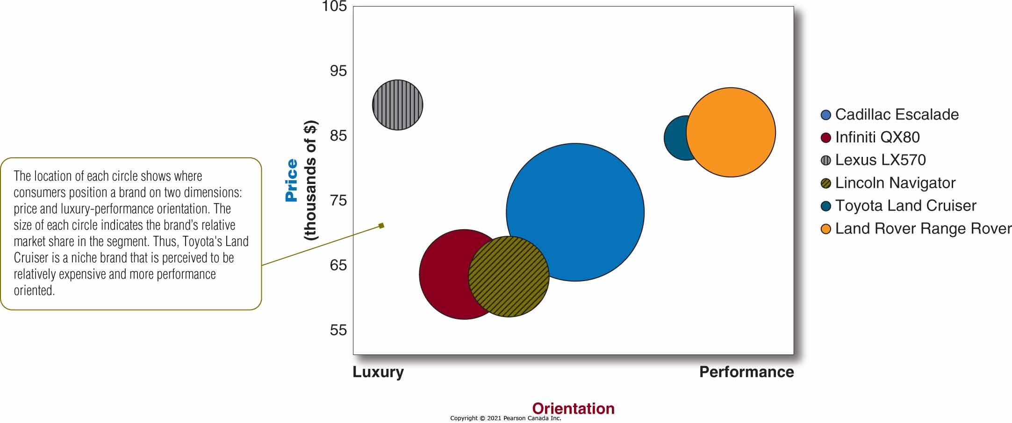
Positioning Maps

Slide 38
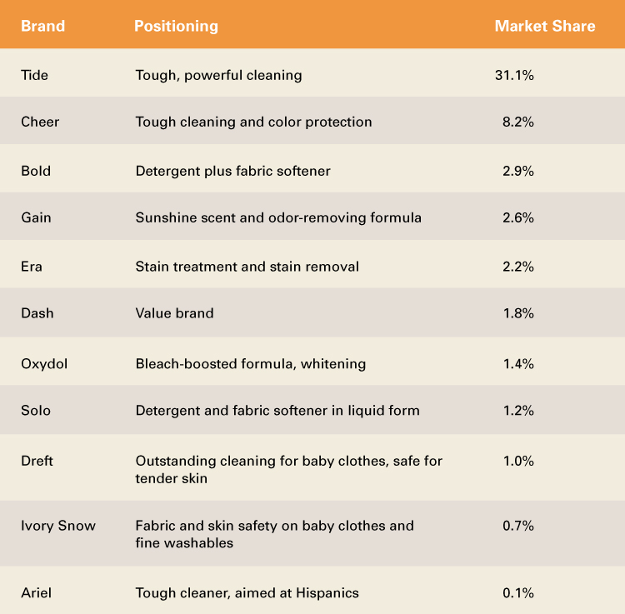
Positioning: Procter & Gamble Detergents

Slide 39
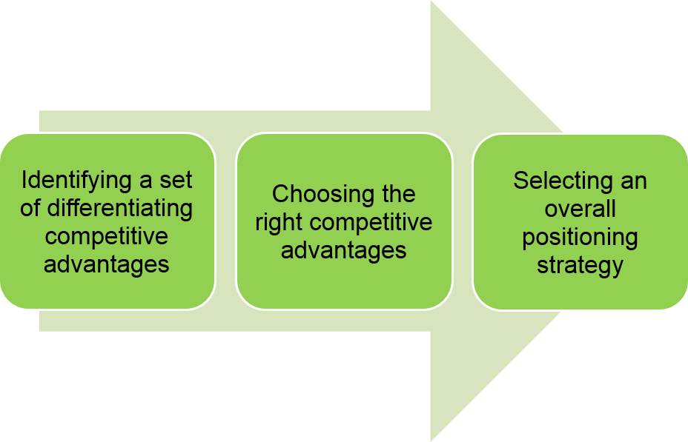
Choosing a Differentiation Positioning Strategy

Slide 40
Choosing a Differentiation Positioning Strategy
Identifying Possible Competitive Advantages
Choosing the right competitive advantage
Selecting an Overall Positioning Strategy
Competitive advantage: An advantage over competitors gained by offering greater customer value either by
Having lower prices, or
Providing more benefits that justify higher prices
Differentiation can be based on:
Products
Services
Channels
People
Image

Slide 41
Choosing a Differentiation Positioning Strategy
Identifying Possible Competitive Advantages
Choosing the right competitive advantages
Selecting an Overall Positioning Strategy
How many differences to promote?
Unique selling proposition
Several benefits
Which differences to promote? Criteria include:
Important
Distinctive
Superior
Communicable
Preemptive
Affordable
Profitable

Slide 42
Choosing a Differentiation Positioning Strategy
Identifying Possible Competitive Advantages
Choosing the right competitive advantages
Selecting an Overall Positioning Strategy
Value propositions represent the full positioning of the brand
Possible value propositions:
More for more
More for the same
More for less
The same for less
Less for much less

Slide 43
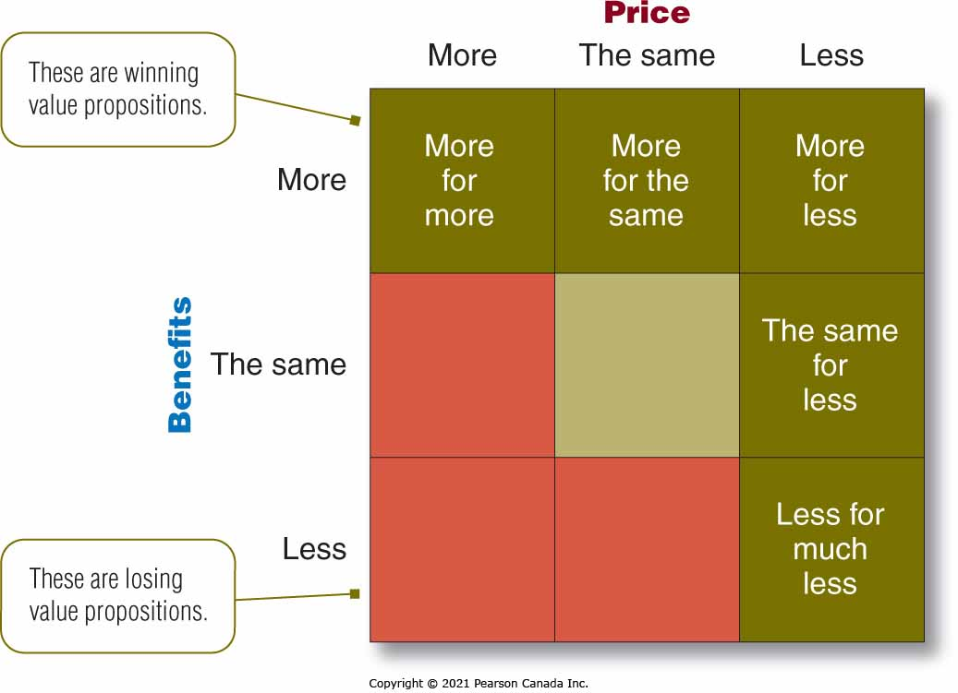
Selecting an Overall Positioning Strategy
e.g., Dell, P&G
e.g., Mercedes-Benz
e.g., Lexus
e.g., Amazon, discount stores
e.g., discount airlines

Slide 44
Winning Value Propositions
Value proposition | Description
More for more | Provides the most upscale product or service
More for the same | High quality at lower prices
More for less | Best winning proposition
The same for less | Gives a good deal
Less for much less | Meeting consumers’ lower performance or quality requirements at a lower price

Slide 45
Developing a Positioning Statement
A positioning statement summarizes the company or brand positioning
EXAMPLE: To (target segment and need) our (brand) is (concept) that (point-of-difference)
“For those cola drinkers who really need a lift, Bam! Cola offers all of the sugar and twice the caffeine!”

Slide 46
Communicating and Delivering the Chosen Position
Companies must take strong steps to deliver and communicate the desired position to target consumers
The marketing mix efforts must support the positioning strategy
Maintain the position obtained through consistent performance and communication.
Positions must be monitored and adapted over time to match changes in consumer needs and competitor’s strategies

Slide 47
Approaches to Product Positioning
Head-to-Head Positioning:
competing directly with competitors on similar attributes in the same target market
Coca Cola classic vs. Pepsi classic

Slide 48
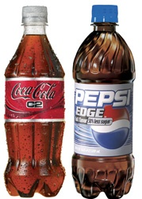

Slide 49
Approaches to Product Positioning
Away/Differentiation Positioning:
Relate to existing mental structures in the consumer’s mind
Position the product against something consumers already know – usually away from the leader
7 Up – the Uncola
Avis –
We are No. 2. We try harder
We are No. 2. Our lines are shorter
Tylenol – for the millions who can’t have aspirin
Jamaica – the Hawaii of the Caribbean

Slide 50
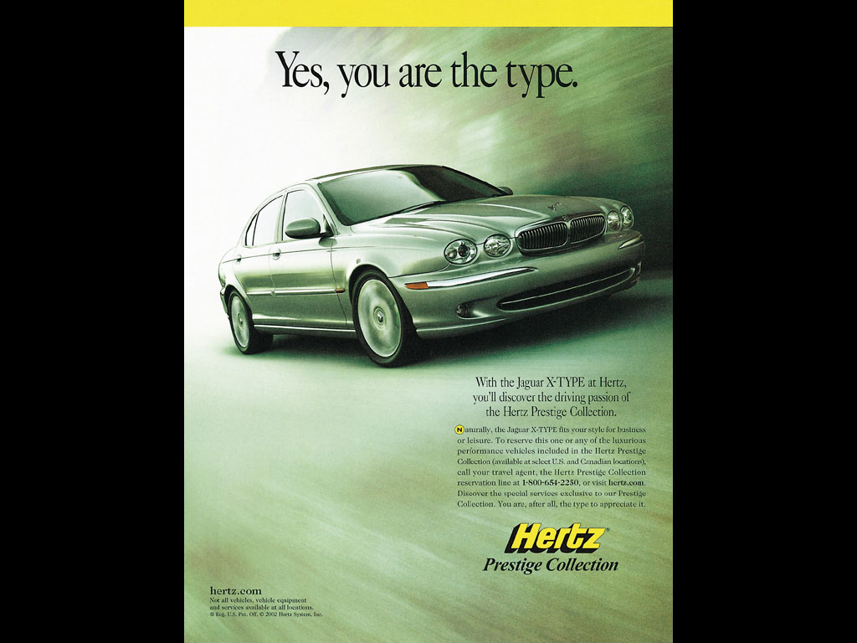
Hertz was No 1.

Slide 51
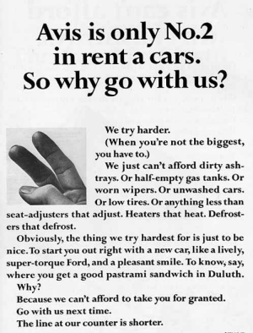

So what does Avis do?

Slide 52
Repositioning
Involves changing the place an offering occupies in a consumer’s mind relative to competitive offerings.

Slide 53
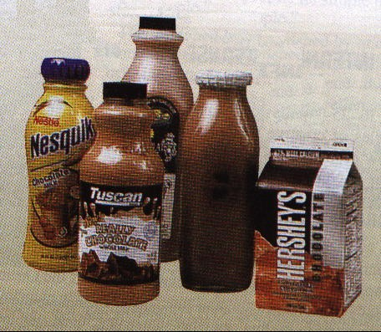
Repositioning
High Nutrition
Orange juice
“Adult” Chocolate Milk
Regular Milk
Chocolate Milk
Nutritionally-designed diet drinks
Milk shakes
Sports drinks
Tea
Children’s Drinks
Adult Drinks
Mineral water
Fruit-flavored drinks
Skinny Latte
Coffee
Sugared soft drinks
Consumers’ Perceptual Map
Low Nutrition

Slide 54
Read Chapter 7

